Slide 1
WORDS to REMOVE From Your Writing

Slide 2
There is no science to my list. Some of these words come from other authors. When I draft a novel, I rewrite/edit four times. On the third pass I break out my list of words I try to remove that helps to button up and make the writing tighter.
Take from this what you can use to make your own writing better.

Slide 3
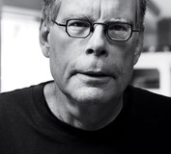
― On Writing: A Memoir of the Craft
“I believe the road to hell is paved with adverbs, and I will shout it from the rooftops. To put it another way, they're like dandelions. If you have one on your lawn, it looks pretty and unique. If you fail to root it out, however, you find five the next day... fifty the day after that... and then, my brothers and sisters, your lawn is totally, completely, and profligately covered with dandelions. By then you see them for the weeds they really are, but by then it's—GASP!!—too late.”
Author, Stephen King

Slide 4
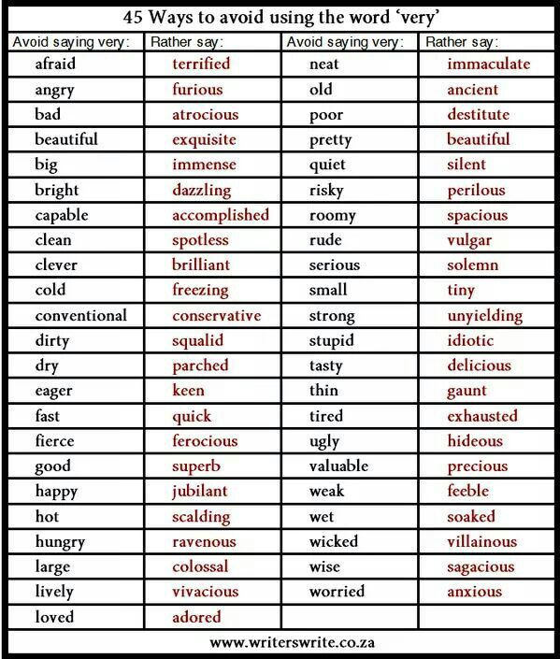
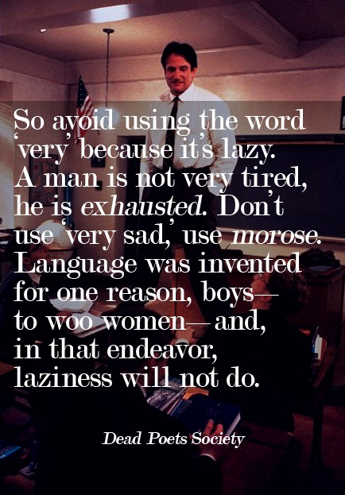
REMOVE VERY

Slide 5
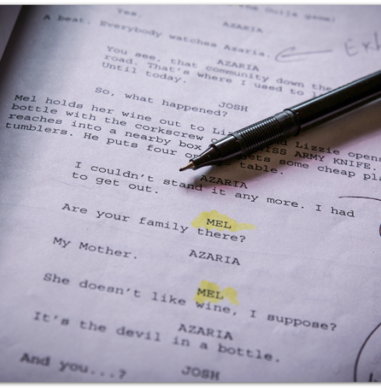
More White Space
Removing of 99% -LY words was a big part of scriptwriting.
SUDDENLY not only an –LY but a forbidden word. SUDDEN goes too.
BEGIN was another. You don’t begin to drink. You drink.
START is the same as BEGIN
By removing many –LY words and other Adverbs you get a stronger sentences.
Get rid of “ing” At least in scripts.
Besides these my Professor also forbid “As you know…” A left over from radio play and is leads into an explanation that returns to telling not showing
<Scriptwriting>

Slide 6
Walk
Walk was another forbidden screenwriting word. We all agreed we spend more time with thesaurus open to Walk than any other word. Walk into a room is stage direction. An angry person does not walk into a room they __________.

Slide 7
hike
jaunt
parade
step
stretch
stroll
tour
airing
carriage
circuit
constitutional
gait
march
pace
perambulation
peregrination
promenade
ramble
saunter
stride
stomp
traipse
tramp
tread
turn
schlepp

Slide 8
These are telling not showing
To see
to hear
to think
to touch
to wonder
to realize
to watch
to look
to seem
to feel (or feel like)
to decide
to sound (or sound like)
I will search for these phrases and then rewrite the sentence to show not tell.

Slide 9
A few others
Useless modifiers
Really
"Amazing" or "Awesome"
Can
Dialogue tag
?” asks
“Said” is not on my list but many authors are suggesting all Dialogue tags
Non-LY ADVERBS
Just
That
so
Telling not Showing
Went
Took

Slide 10
Most of these I remove from prose only.
Dialogue a character may speak in fluffy language.

Slide 11
Every author has her own quirks, and over time, you should become familiar with your own.

Slide 12
It’s –LY but so many novels use “She said sardonically.” I think it needs to go.
One of the vampire novels I read, maybe Rachel Morgan, in one book she constantly said, “I thought about it.”

