Slide 1
National Novel Writing Month
NaNoWriMo 2022

Slide 2
Where Do I start?

Slide 3
MOST IMPORTANT QUESTION:
WHY is NaNoWriMo important?
It helps you learn your pace, if you’ve not established it yet.
It helps you understand that writing can’t wait for the “right” mood.
Inspiration is nice, but the words can flow without inspiration.
You gain confidence!
You’ll get most, if not all, of a first draft done of a book, collection of stories, script, etc.
You are one step closer to publishing!
You’ll realize you can write ANYWHERE!
AND we want to see YOUR story!

Slide 4
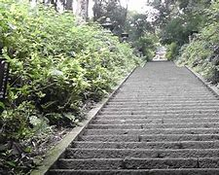
Steps to Success
Develop a Story Idea You’re Passionate About
Create Complex, Believable Characters
Construct a Detailed Plot or Outline
(That will keep you on track with your story)
Build a Strong World for Your Characters
Organize Your Life to Support Your Writing Goals
(And get your community involved.)

Slide 5
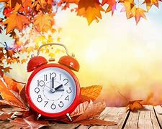
TIME!
Find, Schedule, and Manage Your Time
So you can write as much as possible.
Make regular dates with your creative self this November.
Give yourself the space and attention to accomplish your goals!

Slide 6
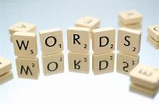
1667 WORds per DAY…oh my!
Writing 1,667 words a day is a challenge!
It’s a challenge made easier if you can find the writing time in your schedule right now.
Make regular dates with your creative self this November.
Give YOURSELF the space and attention to accomplish your goals!

Slide 7
Suggestions
Like anything that is worthwhile - failing to plan is planning to fail.
Let your family and friends know – they want to help you!
It’ll help eliminate confusion.
They’ll thank you for the heads up.
They will help boost your chances of success.

Slide 8
Suggestions…keem ‘em Coming
Set aside time each day to write…even on Thanksgiving. (Unless you’re done already.)
Pick a certain time of day to write.
Let folks know in your household each day.
If you get done, and you have time, write some more to get ahead.
Turn off/set aside your phone.
Even seeing the phone is a distraction.
Use an app to concentrate.
If you miss a day. Its okay, really. Begin again.

Slide 9
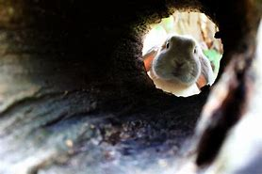
Should you Use the internet during the writing session?
Sure, but it is NOT recommended while writing.
The Rabbit Hole is a dreaded enemy of productivity!
Save the internet time, even for research, when you aren’t writing.
Even having your phone in your visual field reduces your productivity.

Slide 10
Forest - Stay focused, be present (forestapp.cc)

Slide 11
Should you be editing during November?
Its not a good idea. NO editing! None. Don’t even THINK about.
Misspelled words? – keep ‘em and keep on writin’.
Bad grammar? Sure, why not? You’ll get to those issues AFTER November 30.
Dialogue stinks? Of course, that’ll happen. “Fix it…LATER,” Mr. NaNo intones.
Can’t remember a name, thing, or place? That’s ok, too. Just use a placeholder.
Examples
I wish I could think of [ ].
Why won’t that ____ come to my mind?
Use this strategy so that later you can find those placeholders by using the Find feature in Word.
Editing is for later drafts after Nov 30!

Slide 12
Wow Suggestions:
From Taylor:
Stephen King suggests "writing with the door closed," that is, not letting anyone see your first draft until you're completely finished with it.
It’s more effective to spend time alone with the plot, focus solely on word count, and invite others in AFTER you've put the last period in your draft.
Basically – you may NOT want to offer selections from NaNo during November. Reasoning: it’ll tempt you to EDIT your selections.
We’ve already discussed the issues with editing during November. ☺

Slide 13
What happens if you fall behind?
Life will continue – your writing is still there. NaNo is tough, yet it is fun!
Begin again, as soon as possible.
Regret or guilt are hinderances. By focusing on the past, you’ll actually lose time working.
Every word you write is moving forward.
It’s November 20 and you’ve only got 22,202 words? So what. Keep writing. ☺
Re-evalate your writing time – is there something distracting you?
Stay ahead of the word count from the beginning. Example, write 2000 words a day for a few days.

Slide 14
More Tips
Visit this link for MANY tips!
https://nanowrimo.org/nano-prep-101?fbclid=IwAR0neWgfuvQSpBmOzTuv65NYJ9LAPZa6wS6OSTwUiEimdvBkm6KL9DrY6_Q#week5

Slide 15
My Nano page
Www.nanowrimo.org

Slide 16
Questions?

